Slide 1
Island of Crete
600 miles from Jerusalem as a crow flies
The southern island of Greece in the Mediterranean. Paul left Titus to develop the churches there (Tit 1:5).

Slide 2
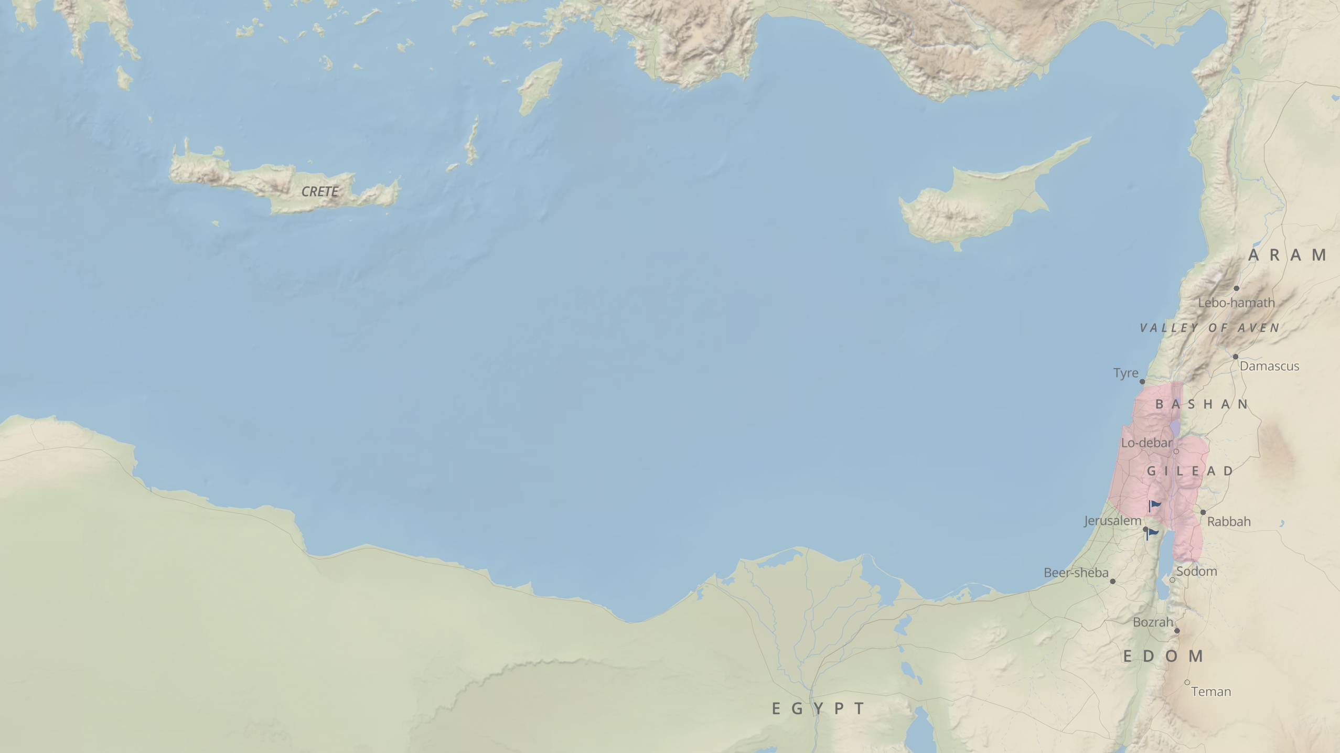

Slide 3
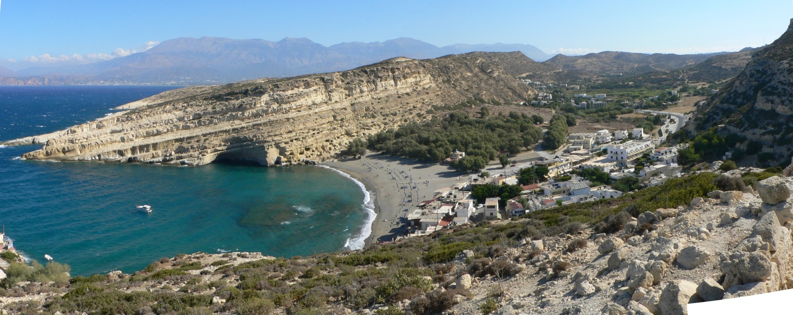

Slide 4
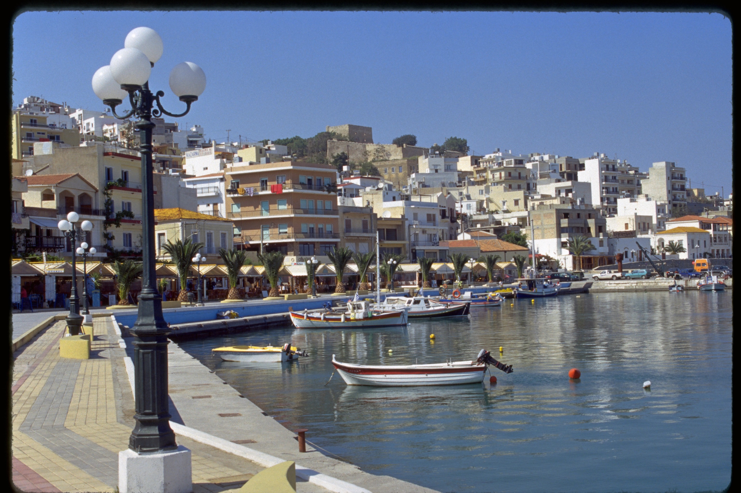

Slide 5
Crete is important in the history of the Christian church. When Paul went to Rome as a prisoner, the ship sought refuge from a storm at Fair Havens (Acts 27:8). The ship tried in vain to reach the more commodious harbor at Phoenix (Acts 27:12), but was blown off course and sought refuge at an island off the southwest coast of Crete, called Cauda (Acts 27:16). Paul may have visited Crete after imprisonment in Rome, for in his letter to Titus, he said, “I left you in Crete” (Ti 1:5).

